Slide 1

Python Simulation Environment
Yaobang Deng
Slide credit: Arash Asgharivaskasi, Tianyu Wang, Nikolay Atanasov
Existential Robotics Laboratory
University of California, San Diego
Author | Date

Slide 2
Motivation
A multi-purpose simulation environment
Easy to interface with robotic algorithms
Baseline functionalities available
Provide an almost realistic test bed for new algorithms

Slide 3
Big Picture
Environment Agnostic
Robotic Algorithms
Pybullet Physics Engine
Perception
Wrapper
Control
Wrapper

Slide 4
Perception
Perception
Localization
SLAM
Mapping

Slide 5
Planning & Control
Set Goal
Planning
Path Planning
Motion Primitives

Slide 6
Pybullet Setup
Prerequisites
Python 3
pip environment (recommended)
pip3 install pybullet
conda environment
conda install -c hcc pybullet

Slide 7
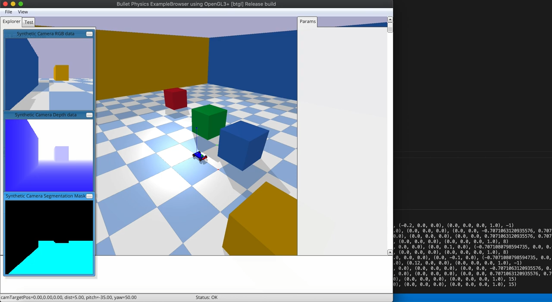
Mapping in Pybullet

Slide 8
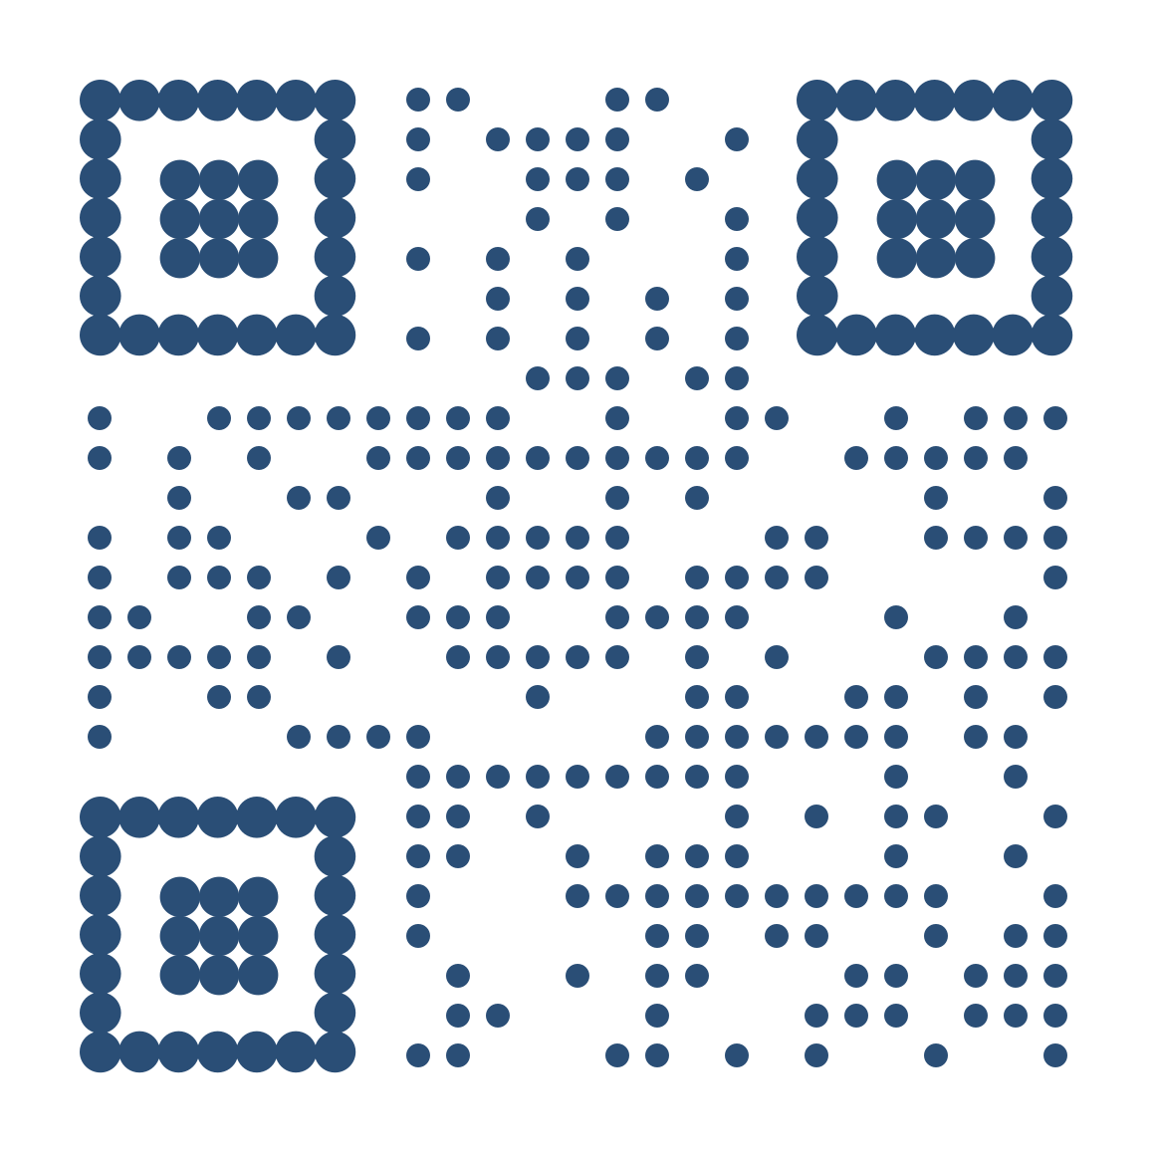
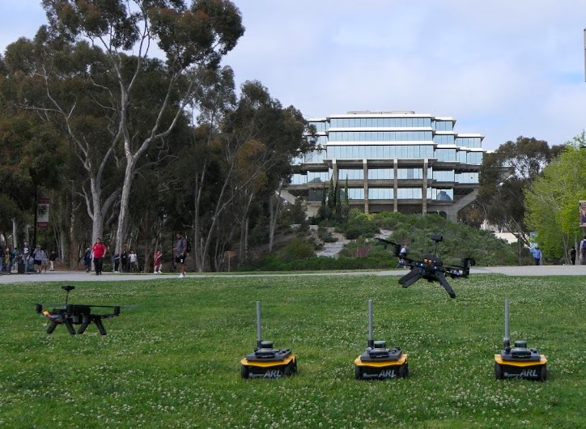



Thank you!
Scan to visit our website!
Existential Robotics
Laboratory
Arash Asgharivaskasi
aasghari@eng.ucsd.edu
8

Slide 9
Thank you!

